Slide 1


INDIAN INSTITUTE OF INFORMATION TECHNOLOGY, PUNE
TIME SERIES FORECASTING AND ANALYSIS
SUPERVISIOR:
Dr.Chandrakant Guled
MIS No. | Name of Student
111916012 | Aryan
111916034 | Prachhi Sabita Mishra
111916059 | Vimal Gupta

Slide 2
TABLE OF CONTENTS
01
04
Objective
Introduction
02
05
Motivation
Methodology
03
06
Results , Conclusion and References
Literature Survey and Research Gaps

Slide 3
INTRODUCTION
Time series
In a time series, time is often the independent variable and the goal is usually to make a forecast for the future. In particular, a time series allows one to see what factors influence certain variables from period to period.
Vimal

Slide 4
ABOUT THE PROJECT
By using the covid19 dataset and time series forecasting algorithm using ARIMA we will predict the upcoming trends of the virus spreading. As noticed by experts the virus spreads and peaks during a certain period, we can use this model to predict when exactly the peak is going to come.
Aryan

Slide 5
MOTIVATION
Who doesn’t like prediction and knowing future but it is not just about the thrill of knowing. The prediction makes out life a lot easier. If you are farmer rain forecast would be so helpful. If you are fisherman the storm would definitely change your day. So It can be useful to see how a given asset, security, or economic variable changes over time.
Aryan

Slide 6
LITERATURE SURVEY
Most Common data type
Financial prices, weather, home energy usage, and even weight are all examples of data that can be collected at regular intervals.
Univariate Forecasts
Several aspects of time series analysis includes predictions, univariate forecasts, missing value imputations, time series transformation, and cleaning, etc to achieve an accurate prediction or forecasting results.
Understanding data
Time series analysis can help an analyst to better understand a data set. It is because of the models used help to interpret the true meaning of the data, as touched on previously.
Prachhi

Slide 7
Forecasting Data
It is the basis of the forecasting data. This is because time series analysis — by its very nature — uncovers patterns in data, which can then be used to predict future data points.
PSF Algorithm
The PSF algorithm consists of several tasks, which are broadly divided into two steps, i.e., clustering of data and the forecasting based on clustered data
Prachhi

Slide 8
RESEARCH GAPS
AAR,ARCH,GARCH are not useful for predicting crisis. The affect of nature and white notice is not negligible
Analysing the impact of the single event is so hard because there are often multiple events happening
Generalizations from a single study and accurately identifying the data set.
Vimal

Slide 9
OBJECTIVE
Covid-19
Prediction
Error Catching
Analyzing the data set and predicting the near upcoming events.
Using data of daily cases we try to predict the future cases.
Using mathematical tools to find the error generated by the models.
Vimal

Slide 10
METHODOLOGY
The very first step involves collection of data from authenticated sources .
Processing the program using pandas library, it also cleans, sort with dates and fill the missing values
Analysing the data and finding the correlation among the data.
Prachhi

Slide 11

Fit into ARIMA model using stats model python libraries and checking the validation of model using mathematical parameters.
Debugging the whole code for getting desired output and result.
Visualizing the real values and predicting the values using matplotlib library.
Prachhi

Slide 12
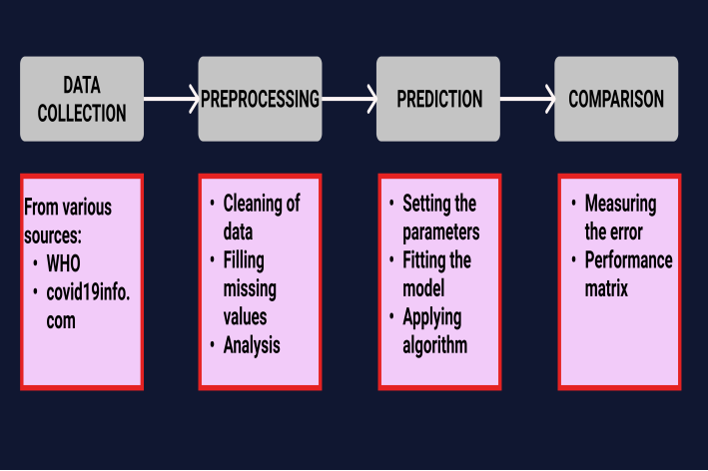
WORKFLOW
Prachhi

Slide 13
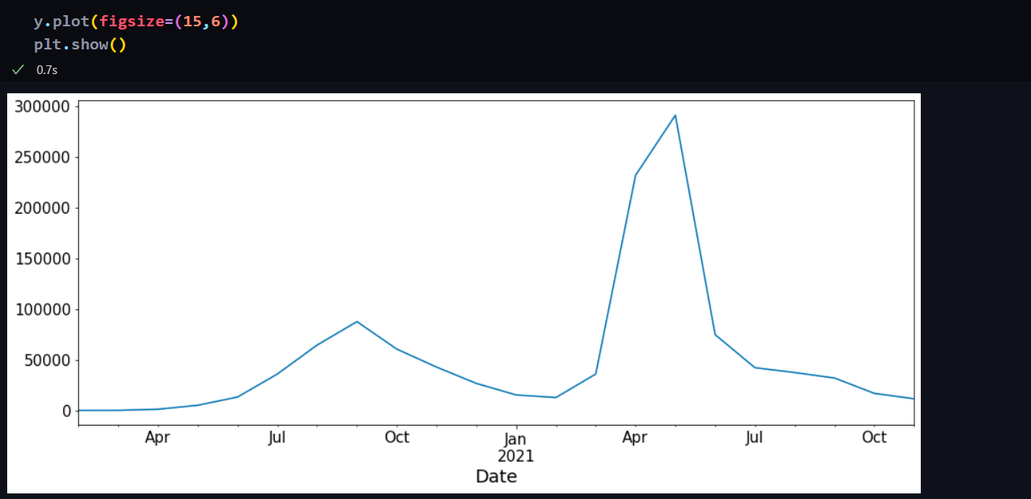
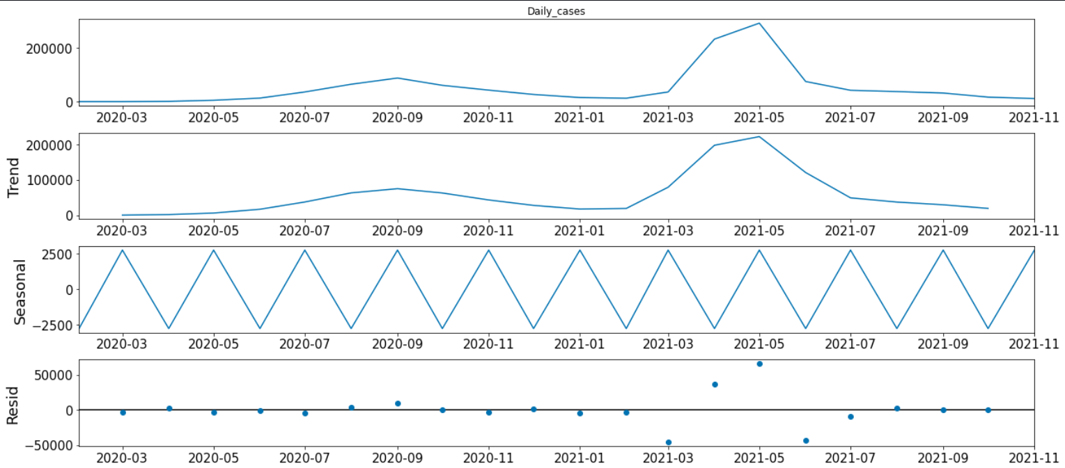
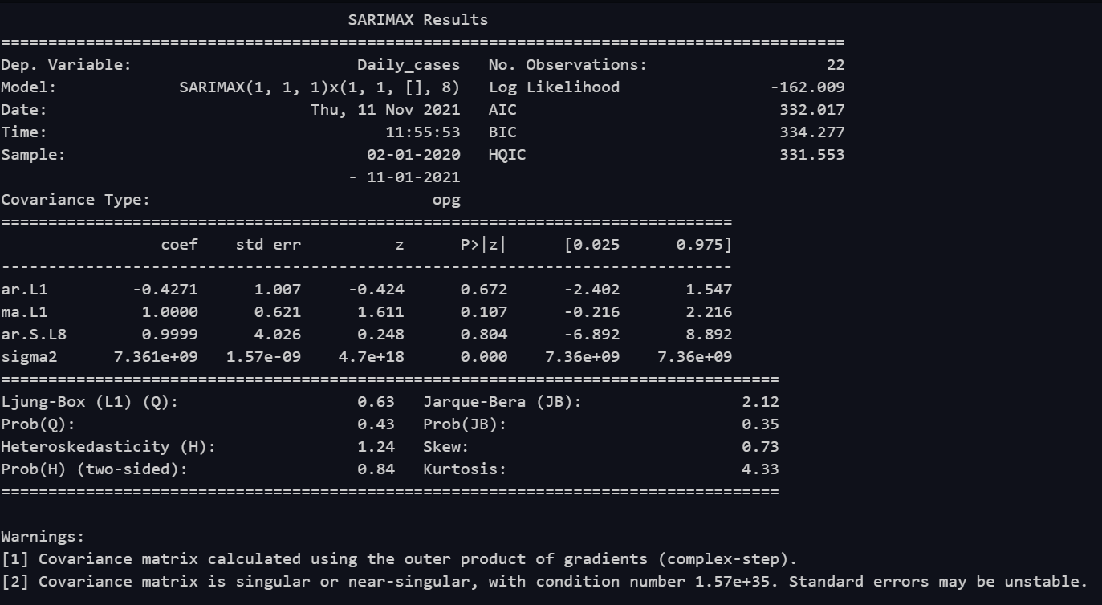
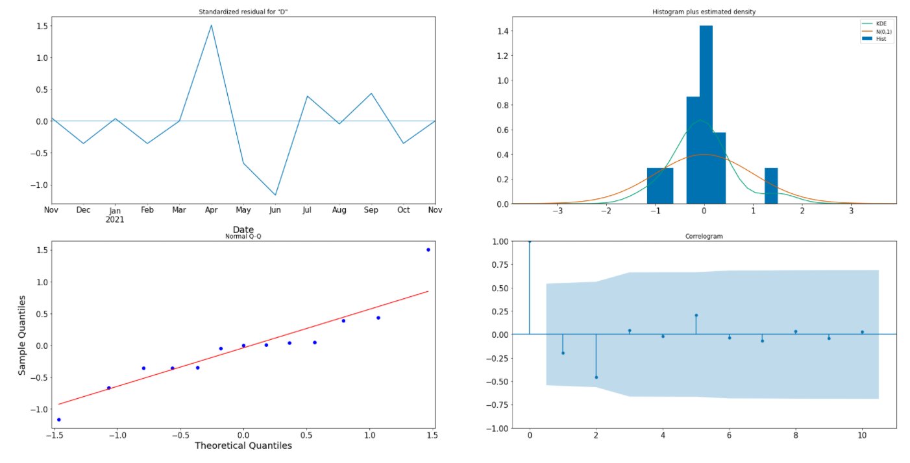
SNEEK PEAK
Prachhi

Slide 14
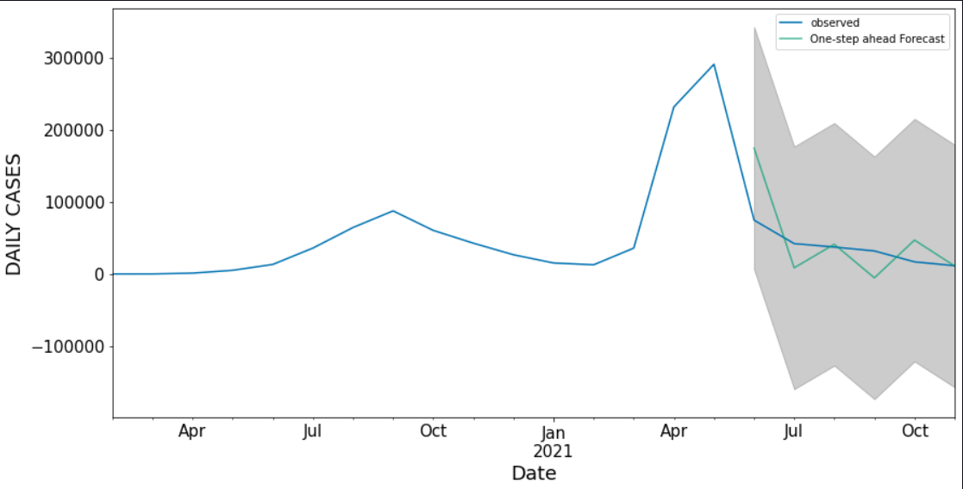
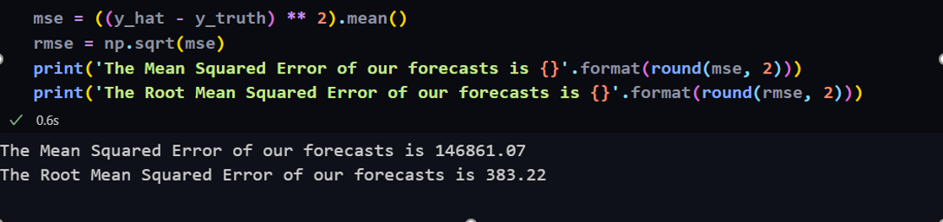

Slide 15
RESULTS
Understood the working of Time series which can be used for non-stationary data and things.
Will approximately tell how the cases will rise with time.
A model to provide the idea of what time daily cases will be highest.
Aryan

Slide 16
CONCLUSION AND FUTURE SCOPE
# Modern time series forecasting
methods are rooted in the idea that
the past tells us something about future.
# Main subject matter of time series analysis is-
how we are to interpret the information
encoded in past events;
how we are to extrapolate future events
based on this information.
# Time series analysis is being researched and
worked upon continuously over years
# So chances of these gaps not being resolved
are negligible which can be noticed in our project.
Vimal

Slide 17
REFERENCES
A Comparative Study and Analysis of Time Series Forecasting Techniques
A Good Alternative for ARIMA Method For Seasonal Univariate Time Series forecasting
https://www.researchgate.net/post/What-are-the-weaknesses-of-time-series-model-and-how-could-it-be-improved
https://www.researchgate.net/publication/229633091_Time_Series_Analysis

Slide 18
THANKS!

